Slide 1

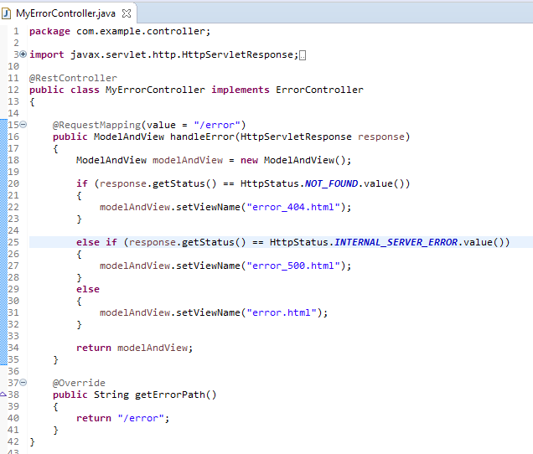
How to display custom error pages in Spring Boot?

